Slide 1
August 14, 2026
Hari Naicker
Biweekly Meeting Recap
Sensor Reconstruction Results

Slide 2
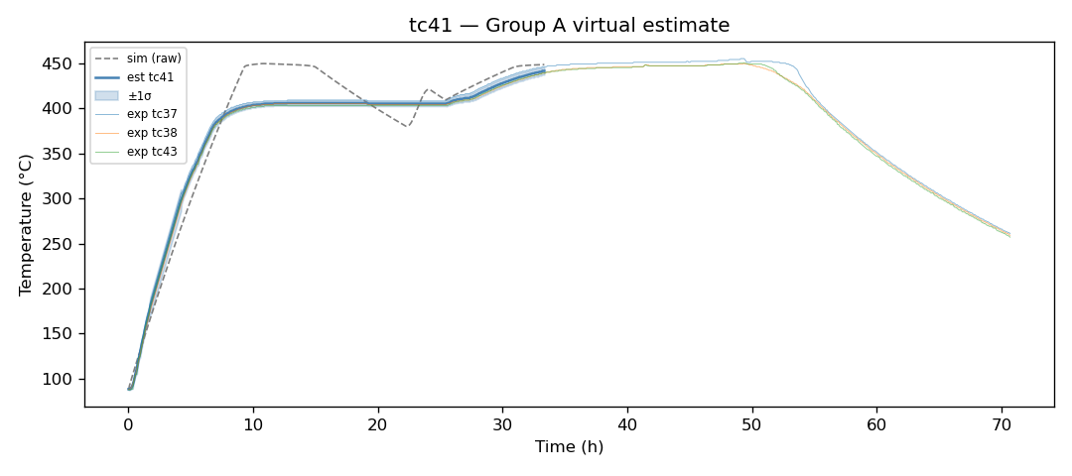
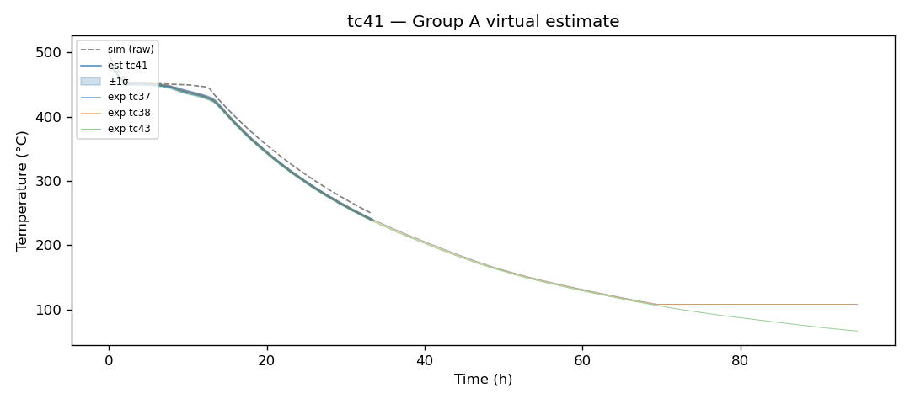
Charging
Discharging

Slide 3
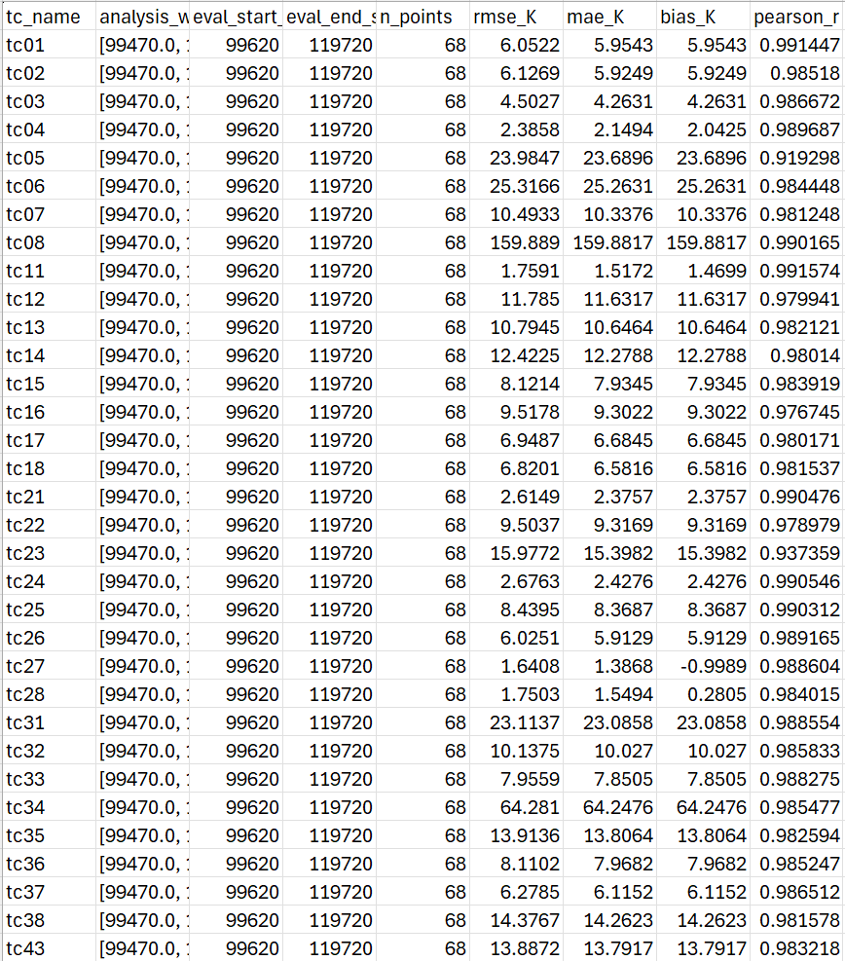
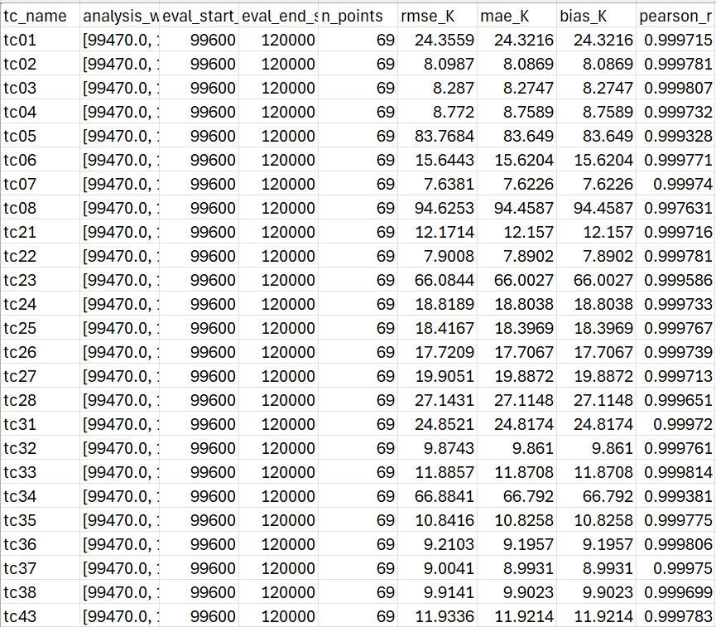
Charging
Discharging

Slide 4
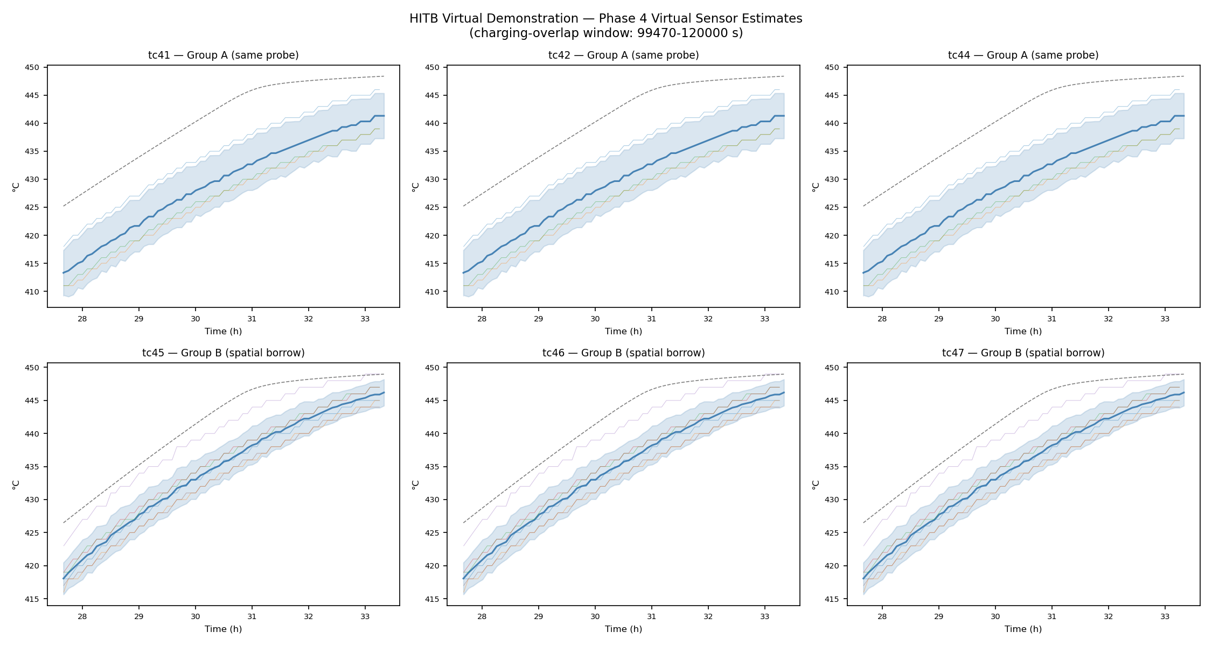
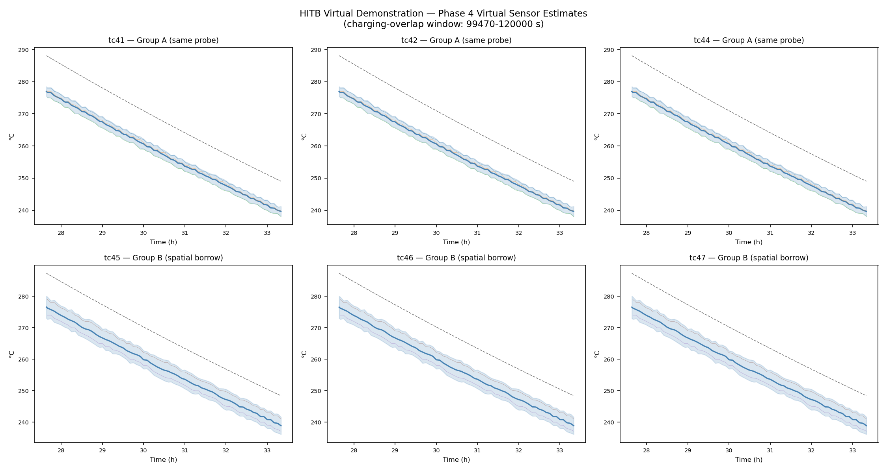
Summary Plots
Charging
Discharging

